Slide 1
IDS Project – Adult Dataset
Chandratop Chakraborty
Abhishek Das
Rohan Biju

Slide 2
Dataset Overview
The adult dataset is census data from the US. The aim is to predict household income based on demographic factors.
Factors include age, relationship, occupation, race, sex, education, native country and a few more.
Contains 32561 rows of data.

Slide 3
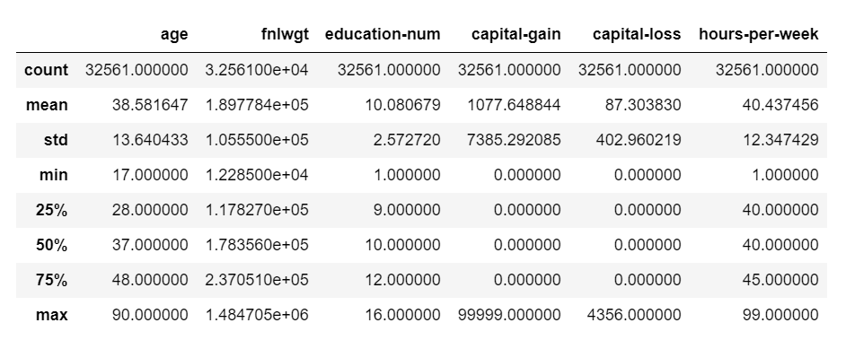
Dataset Overview

Slide 4
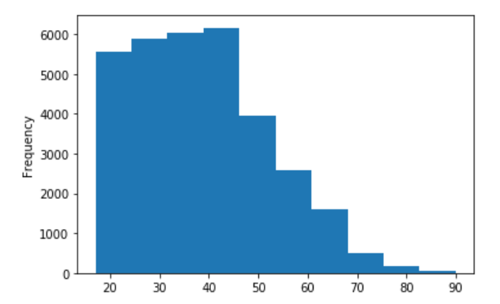
Age distribution

Slide 5
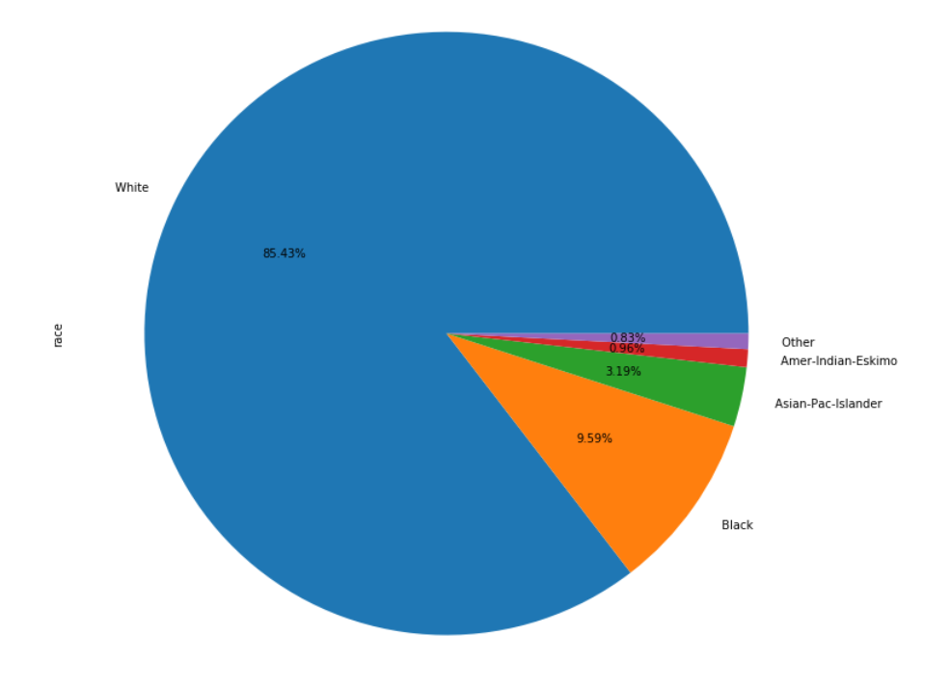
Ethnic group distribution

Slide 6
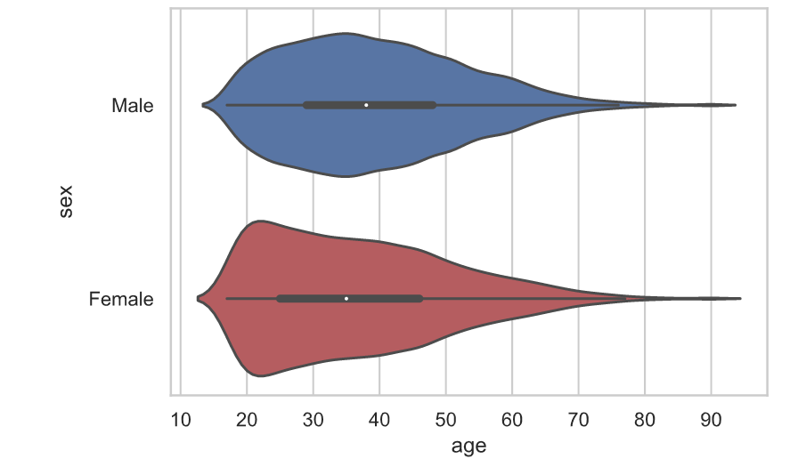
Age Distribution by Gender

Slide 7
Aim
The aim of this dataset is to predict whether income is greater than or less than 50K USD
Now that we have a basic idea of the dataset, we have to find the columns with the maximum correlation

Slide 8
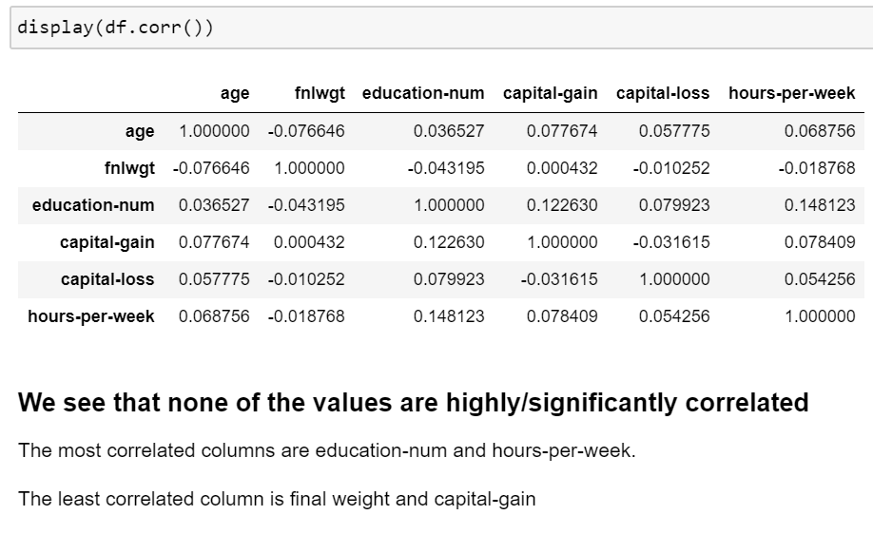
Correlation Matrix

Slide 9
Replacing Missing Values
Replacement of missing or NULL values in the native-country column can be done by evaluating the mode of the column and replacing all the ' ?' values in the column with the mode. In this case the mode clearly is United-States.
Replacement of missing values in the workclass and occupation column can be done by predicting them using Logistic Regression.
Independent variables in this case would be all the other attributes and the column being treated for the missing values would be the dependent variable.
The value of occupation for a row missing its value can be determined using Logistic Regression. This is a multi-class classification problem with around 42 features.

Slide 10
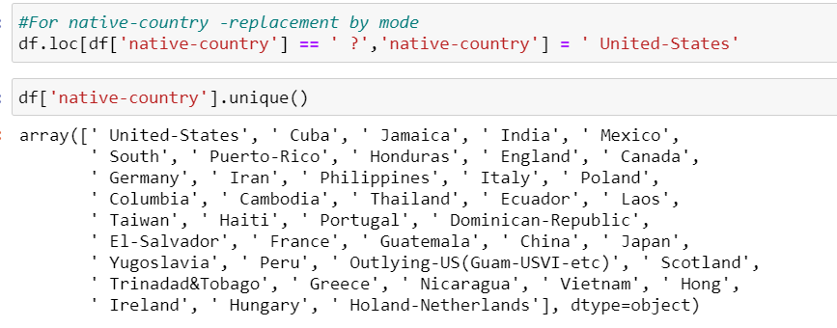

Slide 11
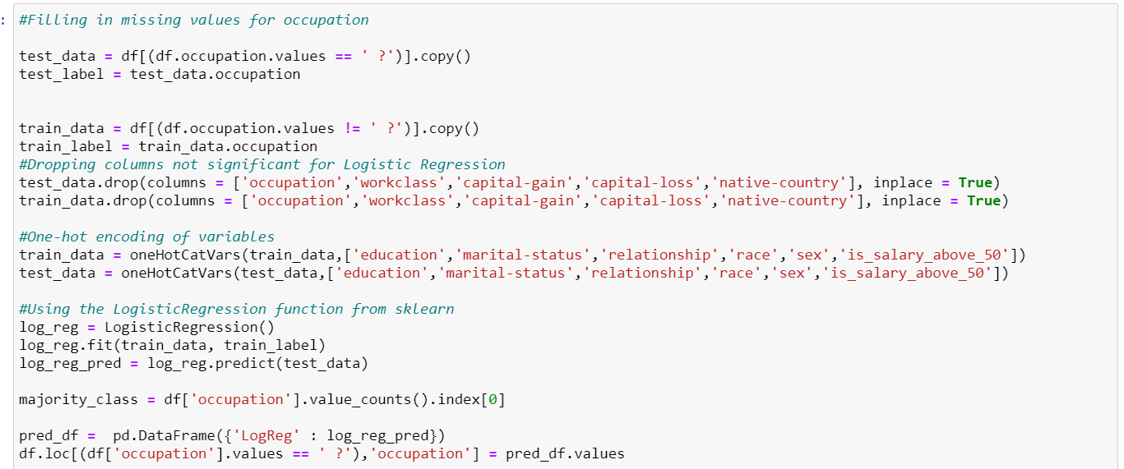

Slide 12
Feature Selection
The model to be created must acheive high accuracy on predicting whether a person's salary is above or below 50K. Therfore some columns which do not convey meaning towards the predictor must be dropped as to not confuse the model and result in lower accuracy.
Features being dropped : -Education and educational-num convey the same meaning i.e. the level of education of a person. So to avoid the effect of this variable to be overstated, one of them (education-num - categorical) will be removed.
-Also the 'Fnlwgt' attribute that is used by the census is not chosen as the inverse of sampling fraction adjusted for non-response and over or under sampling of particular groups. This attribute does not convey individual related meaning.
Categorical variables : workclass , marital-status , occupation , relationship, race, sex , native-country

Slide 13
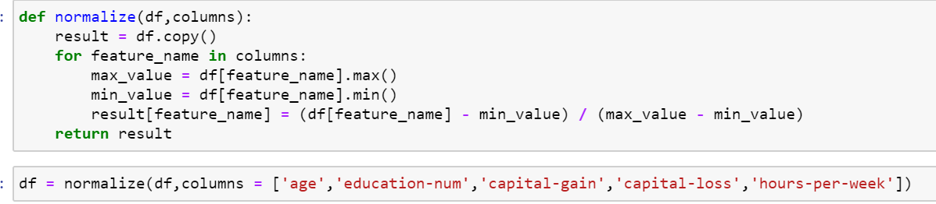
Normalization

Slide 14
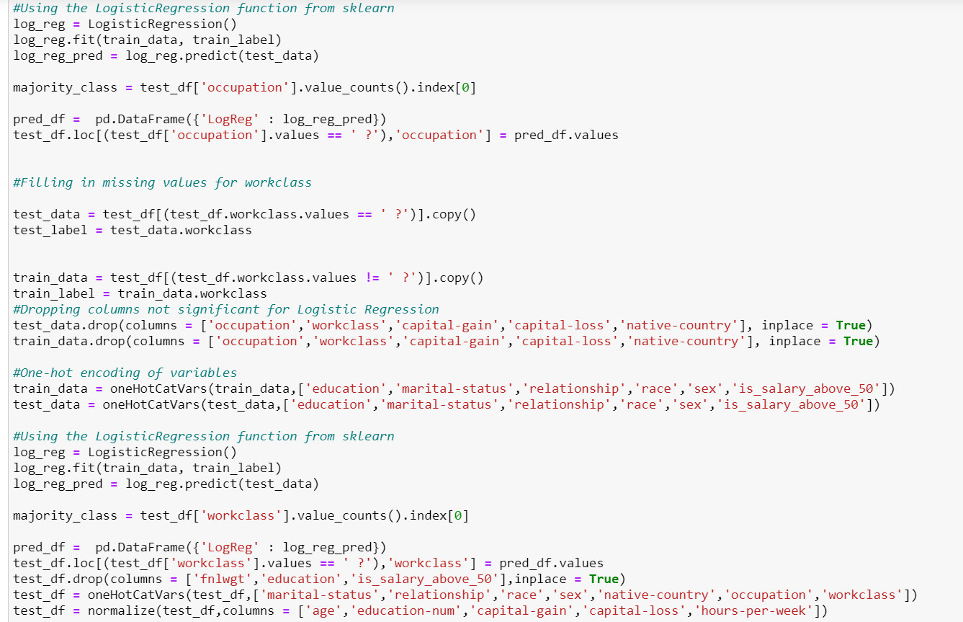
Hypothesis Testing

Slide 15
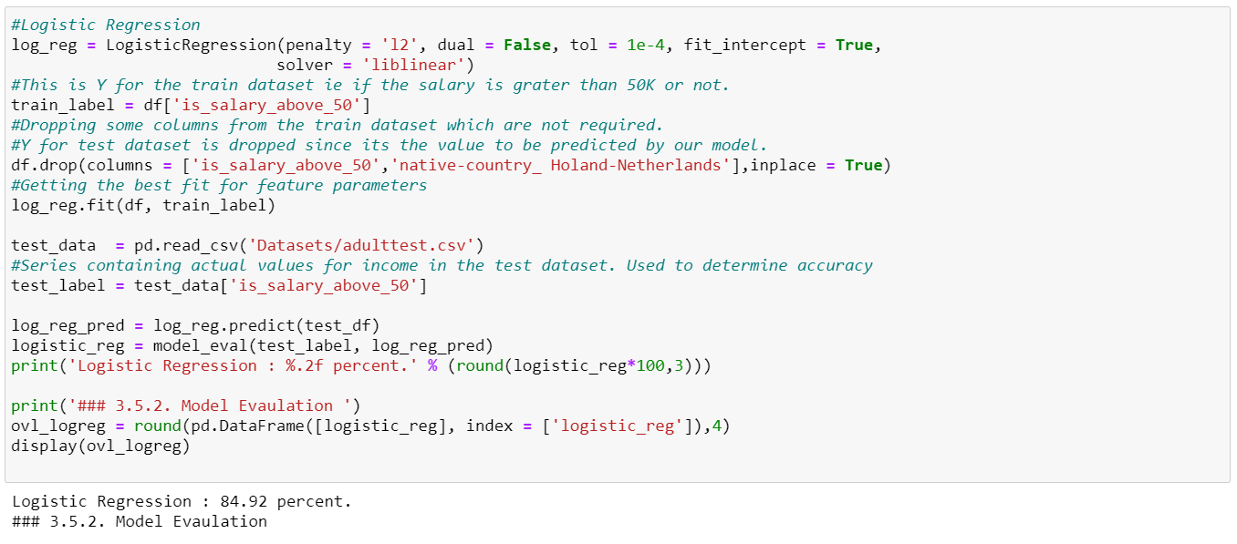

Slide 16
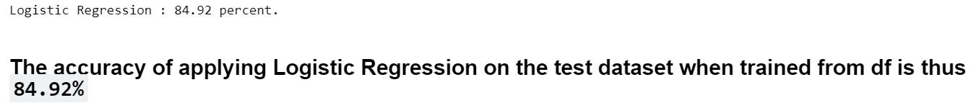
Final Training Result

